Slide 1

Office MACRO Classification
By: Talia Seada & Dana Zorohov

Slide 2
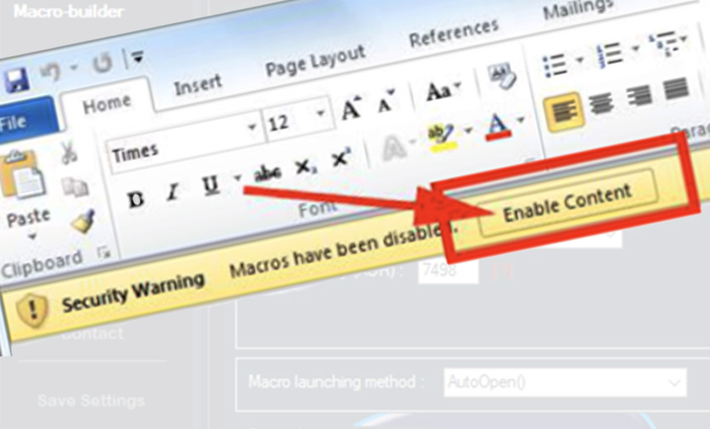
Data Exploration
Preprocessing: General stuff – loading the data, remove unnecessary data
Extracting features:
‘Word2Vec’
'code length’
‘num lines’
‘avg chars per line’
‘num loops'
‘has error handling’
‘has URL or IP’
‘is obfuscated’
‘num string literals'
‘has information disclosure’
‘num numeric literals’
‘num exclamation marks’
‘num functions'

Slide 3
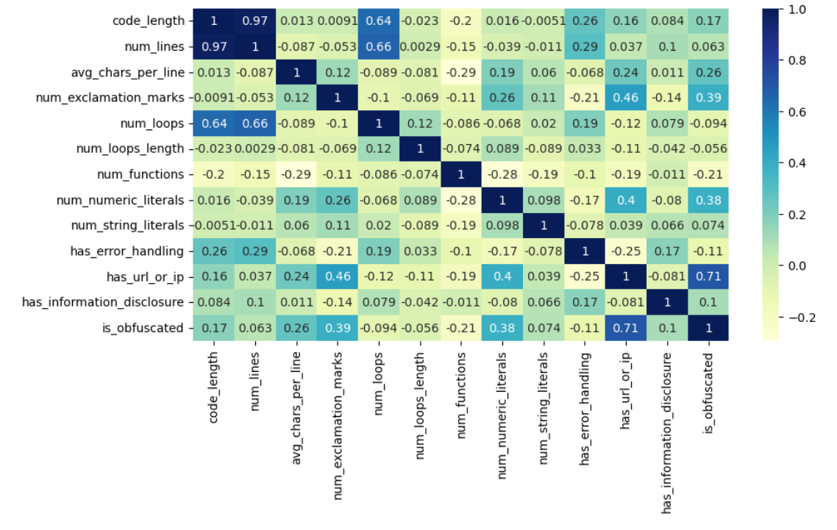
Visualization
Correlation
We have high correlation between ‘has URL’ and ‘is obfuscated’ features, and between ‘has URL’ and ‘num exclamation marks’

Slide 4
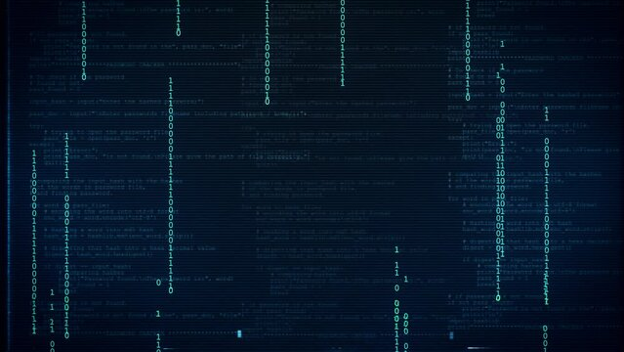
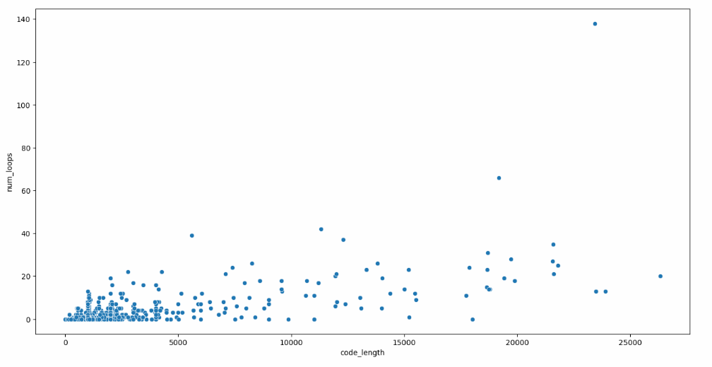
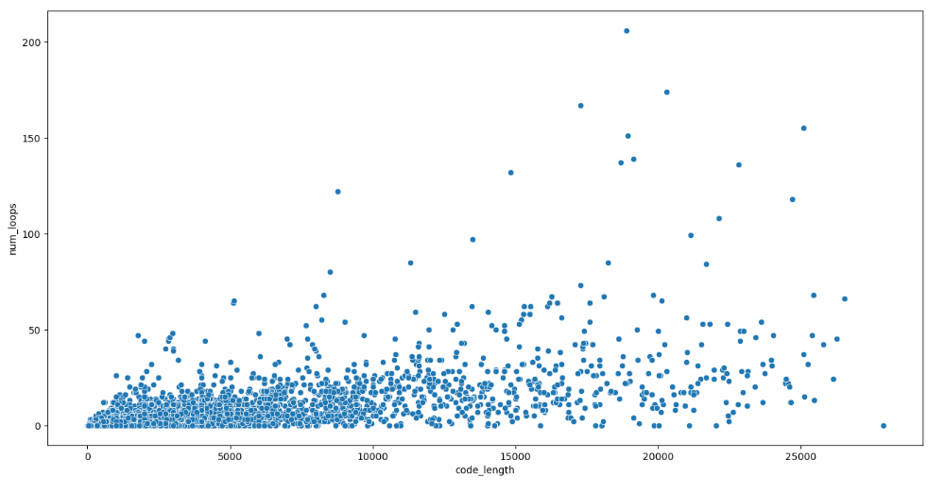
The correlation between ‘code length’ and ‘num loops’
Malicious
Benign

Slide 5
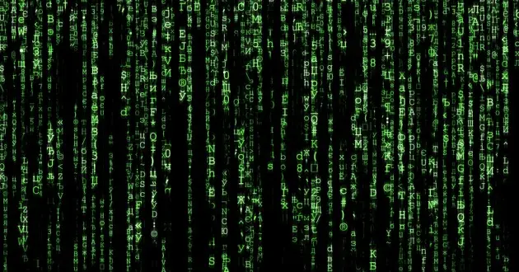
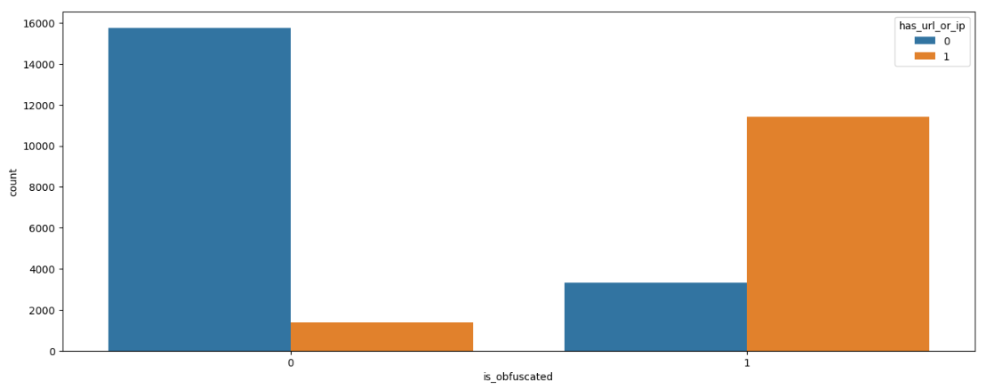
Correlation between the two features: ‘is obfuscated’ & ‘has URL or IP'

Slide 6
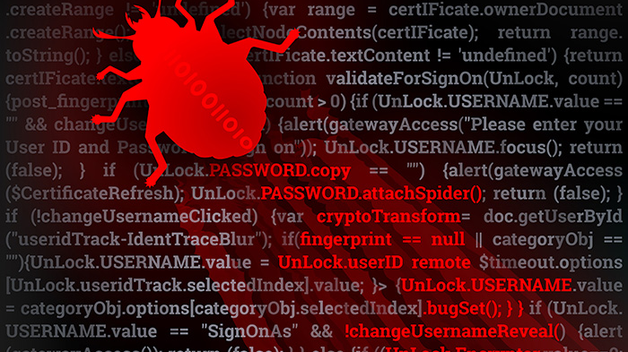
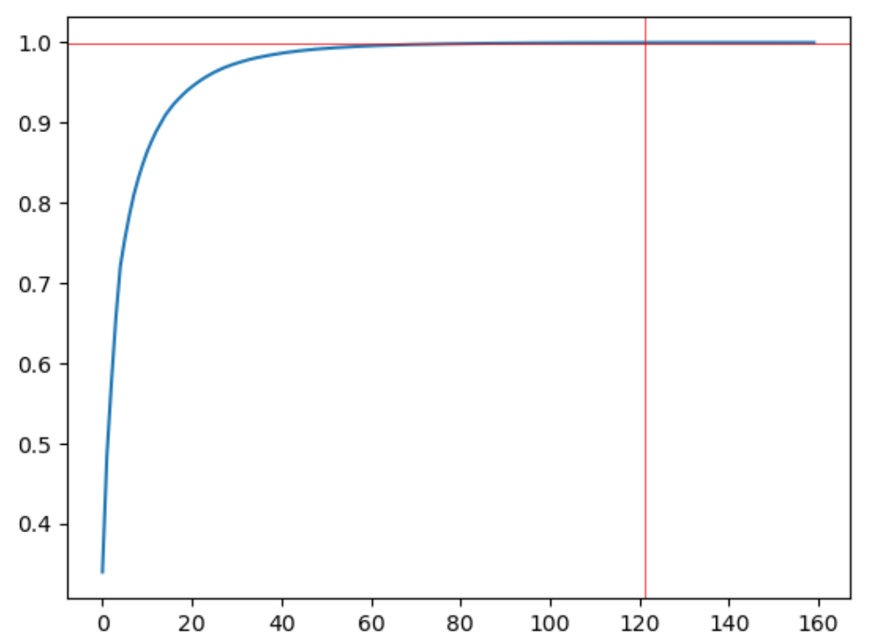
Feature Selection
We used Principal component analysis (PCA) on the vectors we created using Word2Vec and added our 12 extra features (‘has URL or IP’, ‘code length’, etc…)
Explained Variance Ratio

Slide 7
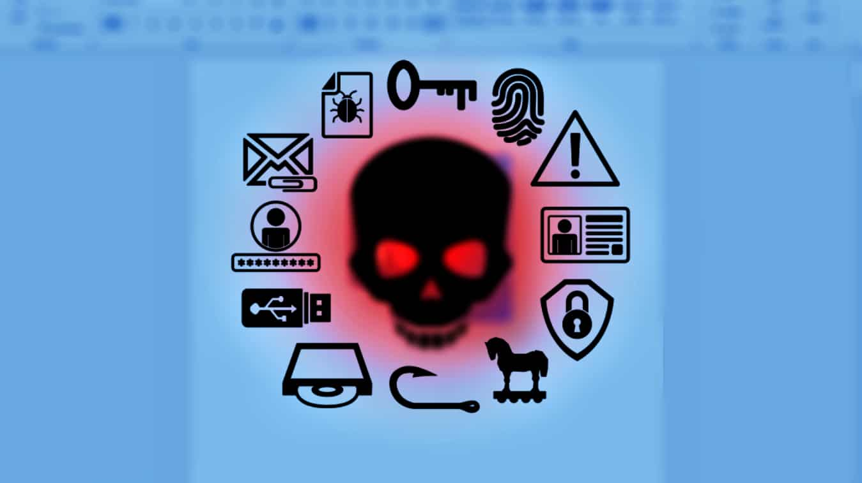
Training (Models)
Gaussian Naive Bayes (not so good)
Decision tree
Ensemble learning
Random Forest Classification
Gradient Boosting Classifier
xgboost
AdaBoost

Slide 8
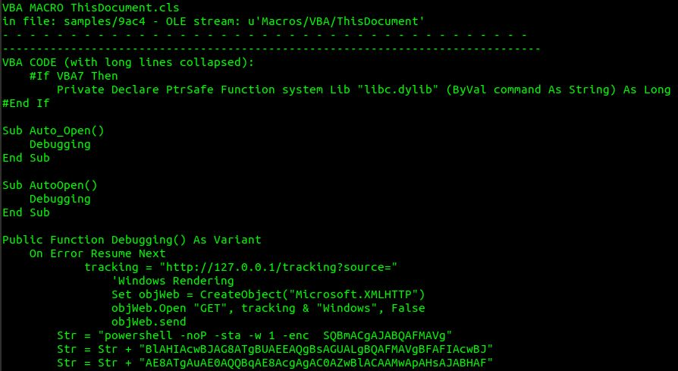
Reducing False Positives & False Negatives
First approach: Hyperparameters tuning
Second approach: adding more features (common words, weird letters)
Third approach: using Word2Vec and the previous features
Fourth approach: using PCA

Slide 9

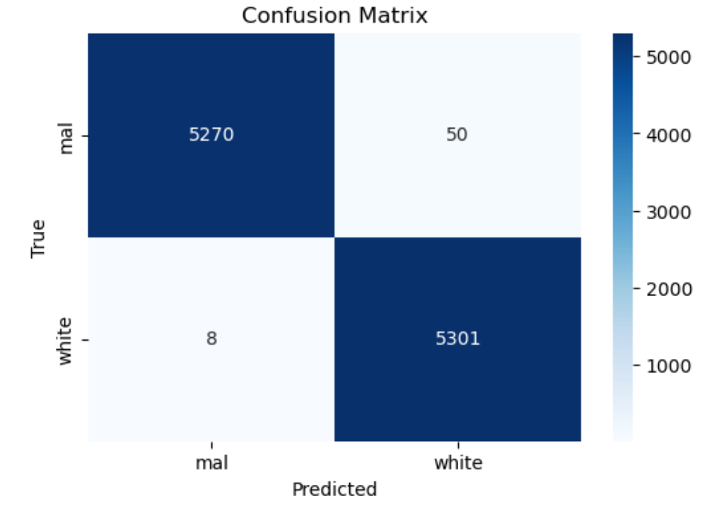
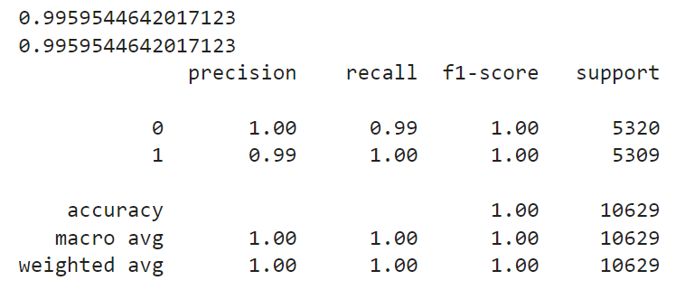
Strongest Model - XGBoost
Classification Report

Slide 10

Future Work
De-obfuscate the obfuscated MACROs – for better analyzing. (there are several tool for that, for example – vmonkey)
Create malicious MACROs and remove duplicates (there are also some tools for that, for example - https://www.blackhatethicalhacking.com/tools/malicious-macro-msbuild/)

Slide 11

References
https://intezer.com/blog/malware-analysis/analyze-malicious-microsoft-office-files/
https://perception-point.io/blog/malicious-office-macros-detecting-similarity-in-the-wild-2/
https://www.logpoint.com/en/blog/detecting-malicious-macros-is-a-vital-tool-in-the-fight-against-malware/
https://appriver.com/blog/201606malicious-macros-and-ole-malware
https://www.sentinelone.com/cybersecurity-101/what-is-a-macro-virus/
https://medium.com/@sasikumarbibin/windows-common-directories-and-threat-actors-3ddcb3c9fad0
https://depthsecurity.com/blog/obfuscating-malicious-macro-enabled-word-docs
https://perception-point.io/blog/malicious-office-macros-detecting-similarity-in-the-wild-2/

